Slide 1

The Fundamentals of Audience Intelligence
Date: Wednesday 7th June 2023

Slide 3
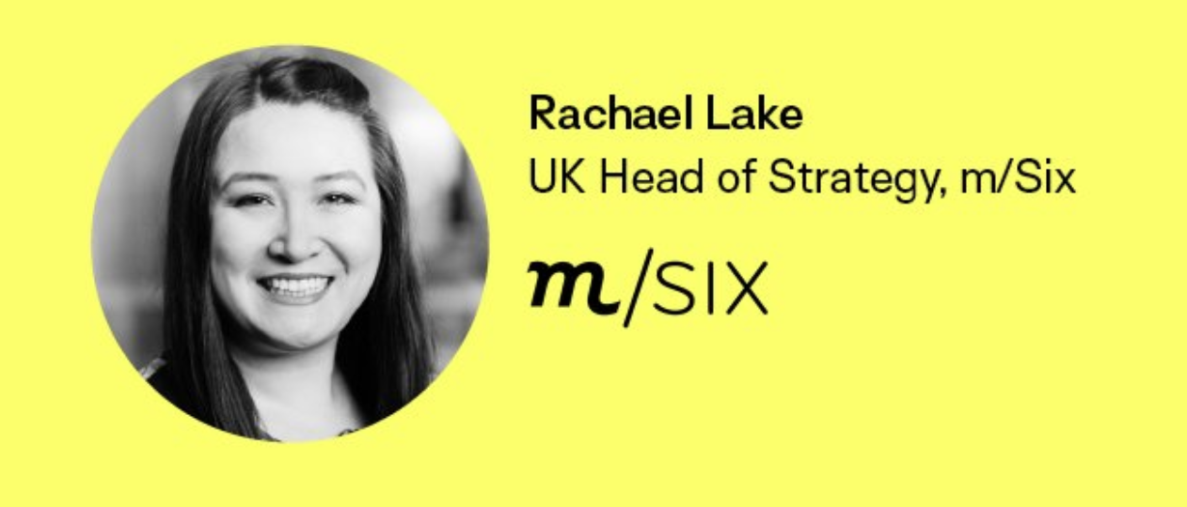
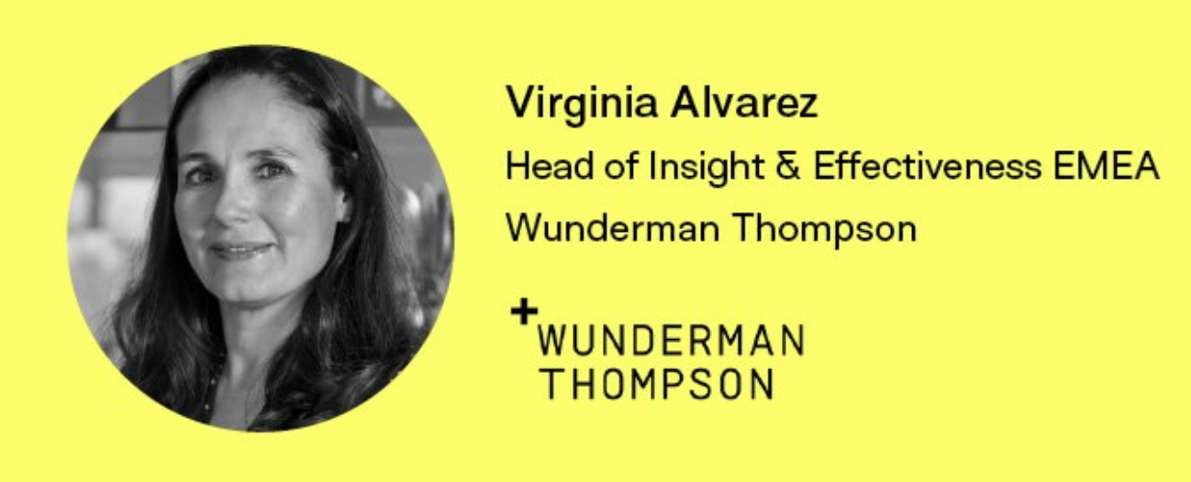

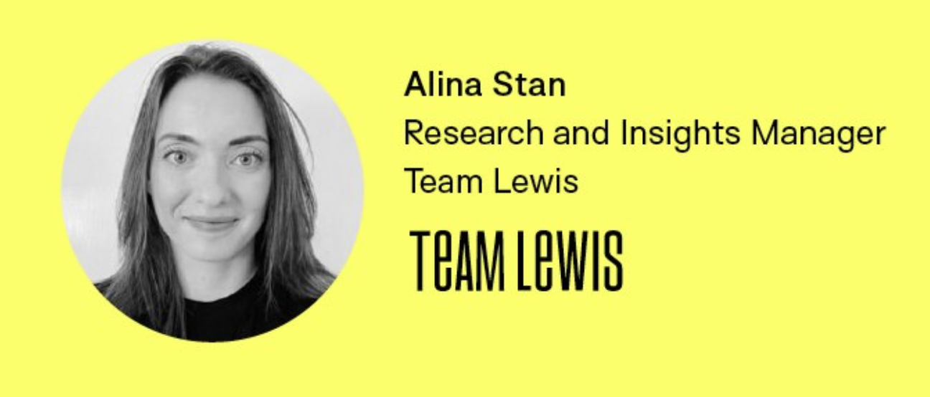
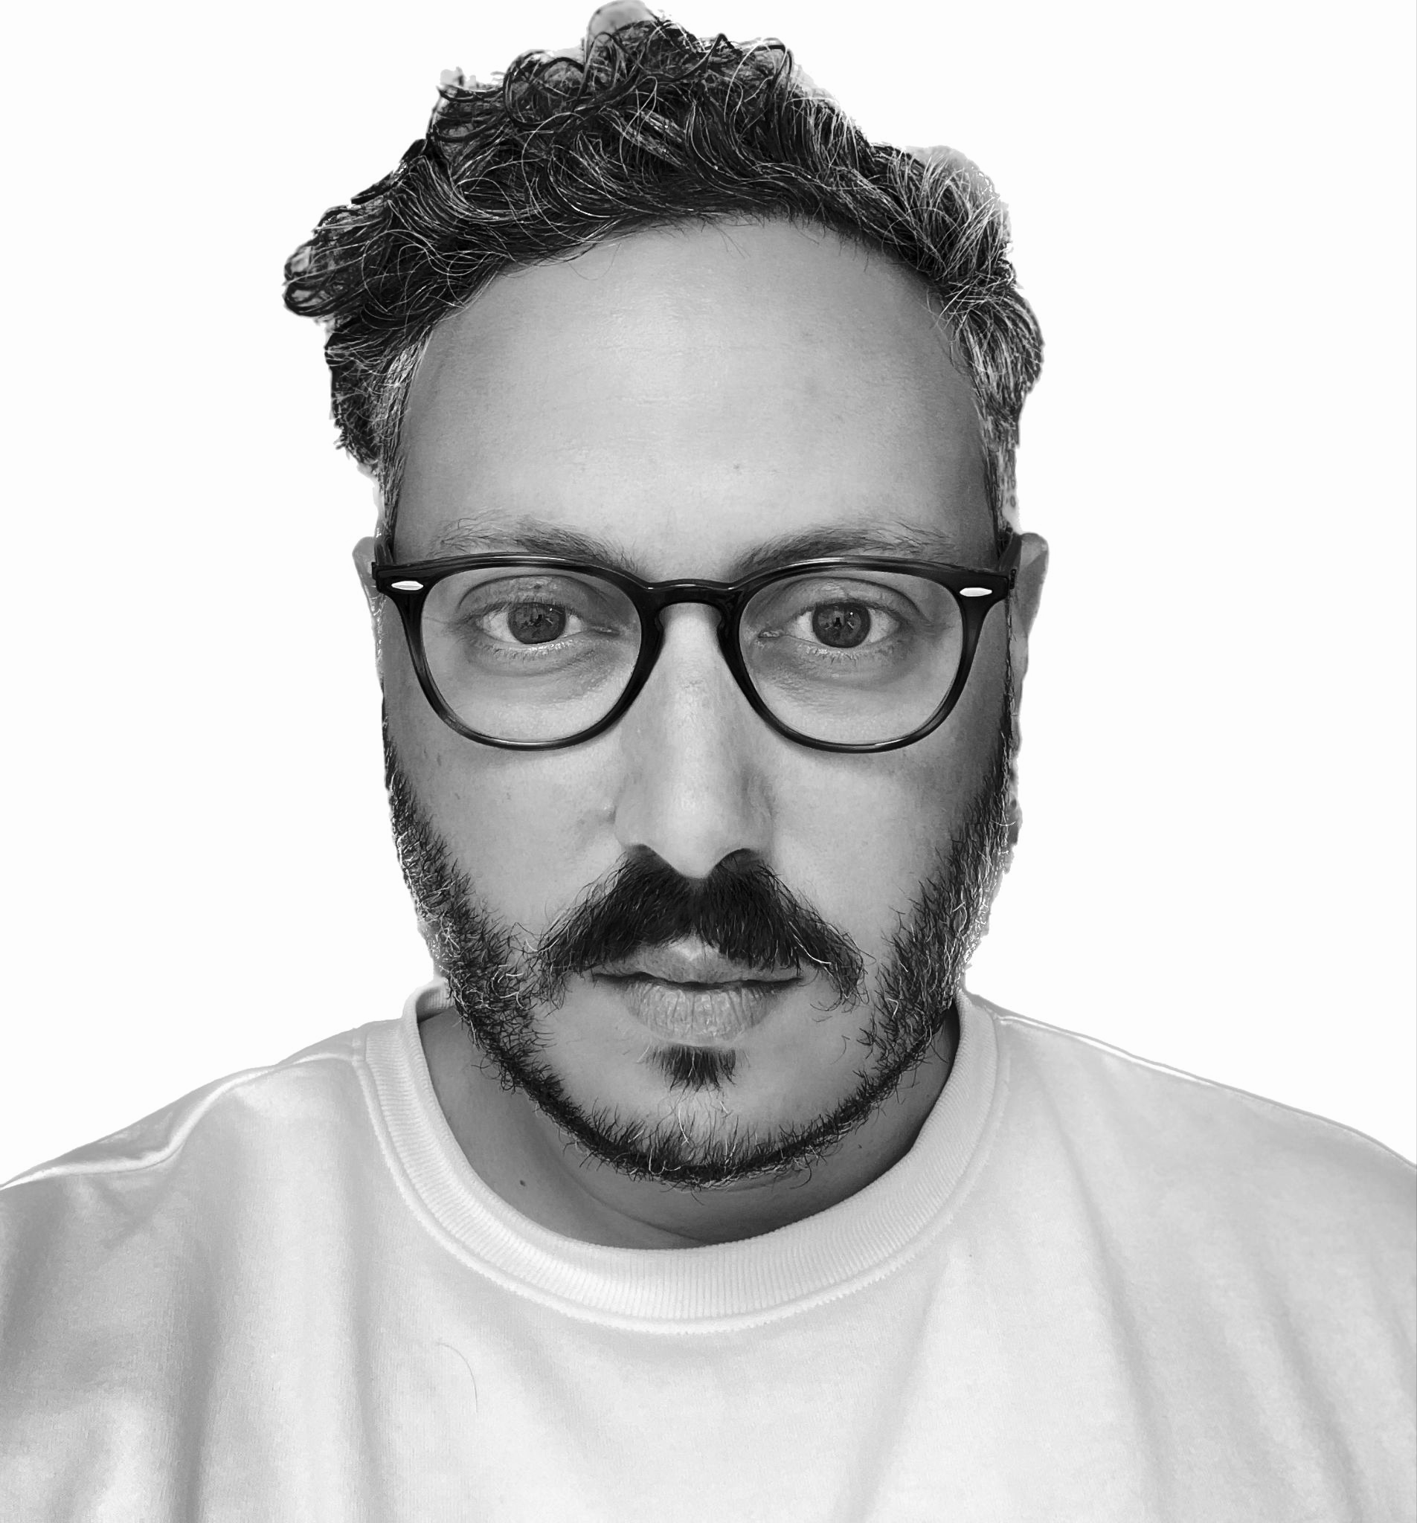

Francesco D’Orazio
Co-Founder & CEO

Slide 4
Unraveling the Mystique:
What really lies at the heart of 'Audience Intelligence'?
Notes:
Let’s define audience intelligence

Slide 5
Weighing the Scales:
Illuminating the pros and cons of audience intelligence - how does it stack up?
Notes:
What do you see as the benefits and drawbacks of using this approach

Slide 6
Clash of the Titans:
Audience Intelligence versus traditional market research - Is it a revolution or evolution?
Notes:
What are the key differences with traditional market research

Slide 7
The Tech Trailblazers:
What groundbreaking tools and technologies are defining the future of audience intelligence?
Notes:
What tools and technologies do you use and what data sources you rely on

Slide 8
Trust and Distrust:
Delving into the credibility of solutions in audience intelligence - How reliable are they, really?
Notes:
What do you trust and not trust about these solutions

Slide 9
The Good, the Bad and the Ugly:
What are the marvels and pitfalls of current tools?
Notes:
1 thing these tools do well, 1 thing they do badly

Slide 10
And, the million-dollar question -
what does the dream solution look like?
Notes:
What does your ideal solution look like

Slide 11
Spotlight on Usage:
Revealing the most innovative, surprising, and successful applications of audience intelligence.
Notes:
What are the key use cases for audience intelligence

Slide 12
The Workflow Revolution:
How is audience intelligence reshaping traditional workflows and processes?
Notes:
Where does audience intelligence fit in your workflow

Slide 13
Case Studies Showdown:
How are brands and agencies redefining success with audience intelligence?

Slide 14
Fast-Forward to the Future:
Envisioning the destiny of audience intelligence - Are we on the brink of a seismic shift?
Notes:
What does the future of audience intelligence look like? How do you see these practices and tools evolving?

Slide 15
AI in the Mix:
With generative AI surging ahead, what are its implications for audience intelligence?
Notes:
How is generative AI going to affect this space?

Slide 16
The Discipline Debate:
Is it time to carve out a distinct 'Audience Intelligence' discipline and category?
Notes:
Do we need an audience intelligence discipline and category?

Slide 17
Thank You

